Slide 1
Agile Planning
Lecturer: Ngo Huy Bien
Software Engineering Department
Faculty of Information Technology
VNUHCM - University of Science
Ho Chi Minh City, Vietnam
nhbien@fit.hcmus.edu.vn

Slide 2

Objectives
To create a product roadmap.
To create a release plan.
To calculate project cost.
To calculate project estimate.
To create sprint tasks.
To create an agile contract.

Slide 3

Contents
High level estimate
Product roadmap
Preliminary release plan
Fixed-date release plan
Fixed-scope release plan
Project (Release) estimate
System architecture
Sprint tasks
Contracts

Slide 4

References
Mike Cohn (2005). Agile Estimating And Planning. Pearson Education.
Ken Schwaber (1995). SCRUM Development Process.
Kenneth S. Rubin (2012). Essential Scrum: A Practical Guide to the Most Popular Agile Process. Addison-Wesley Professional.
Jonathan Rasmusson (2010). The Agile Samurai - How Agile Masters Deliver Great Software. Pragmatic Bookshelf.
Andreas Opelt et al. (2013). Agile Contracts: Creating and Managing Successful Projects with Scrum. John Wiley & Sons.

Slide 5

Problems
You have relatively good product backlog (40 user stories).
How long will it take to develop the product.
What is the cost?
How many people do you need to develop the product?

Slide 6
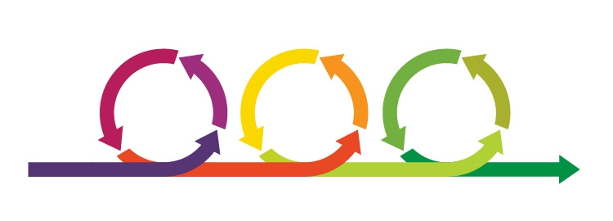
Agile Planning [1]
Agile planning
is focused more on the planning than on the creation of a plan,
encourages change,
results in plans that are easily changed, and
is spread throughout the project.
A good plan is one that is sufficiently reliable that it can be used as the basis for
making decisions about the product and the project.

Slide 7

1. Create a High Level Estimate [2]
How?

Slide 8
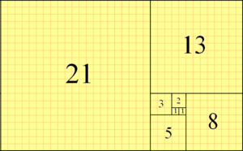

A Technique
1, 2, 3, 5, 8, 13, 21, 34, 55, 89, 144, 233, 377, 610, 987, …
The key here is about relativity.
Smallest thing: 1. Biggest thing: 21.
Pick one familiar thing, give it 3, for example, based upon your experience. Pick another thing. Is it bigger or smaller than the previous one?
We CAN'T come up with accurate estimates!!!

Slide 9
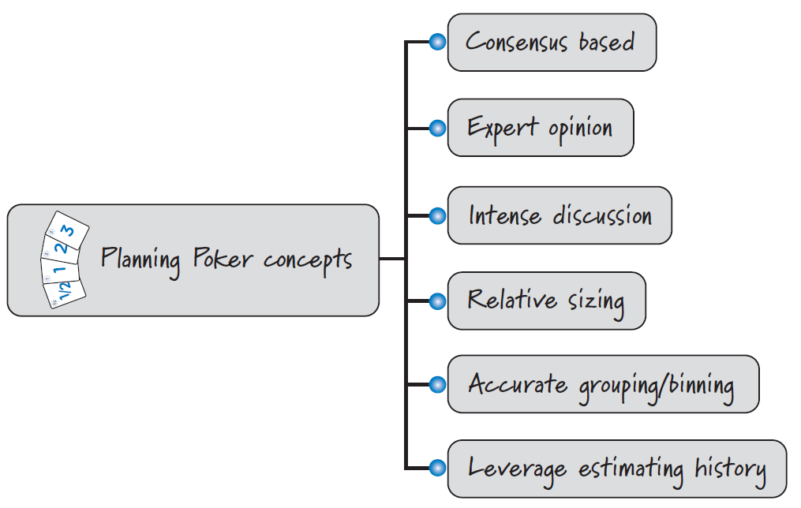
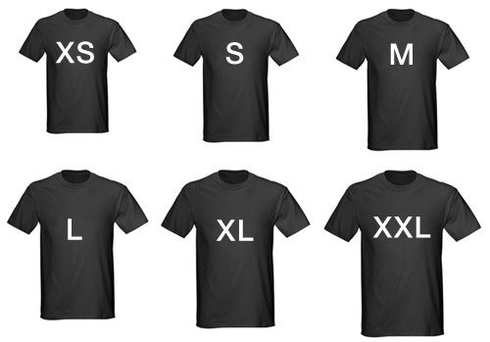
Some More Techniques [3]

Slide 10


Slide 11
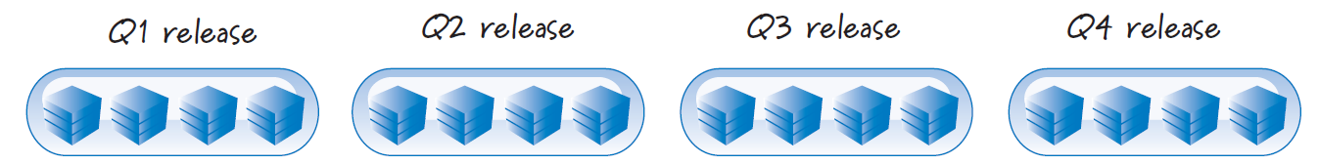
2. Create a Product Roadmap
Product roadmap: A series of releases for achieving some or all of our product vision.
If we are planning only a single small release, we don't need a product roadmap.
Releasing frequently doesn't mean we set overly aggressive deadlines; such deadlines frequently result in missed dates.
Instead, we focus each release on a small set of minimum releasable features (MRFs) around which the stakeholder community shares a strong group consensus.

Slide 12
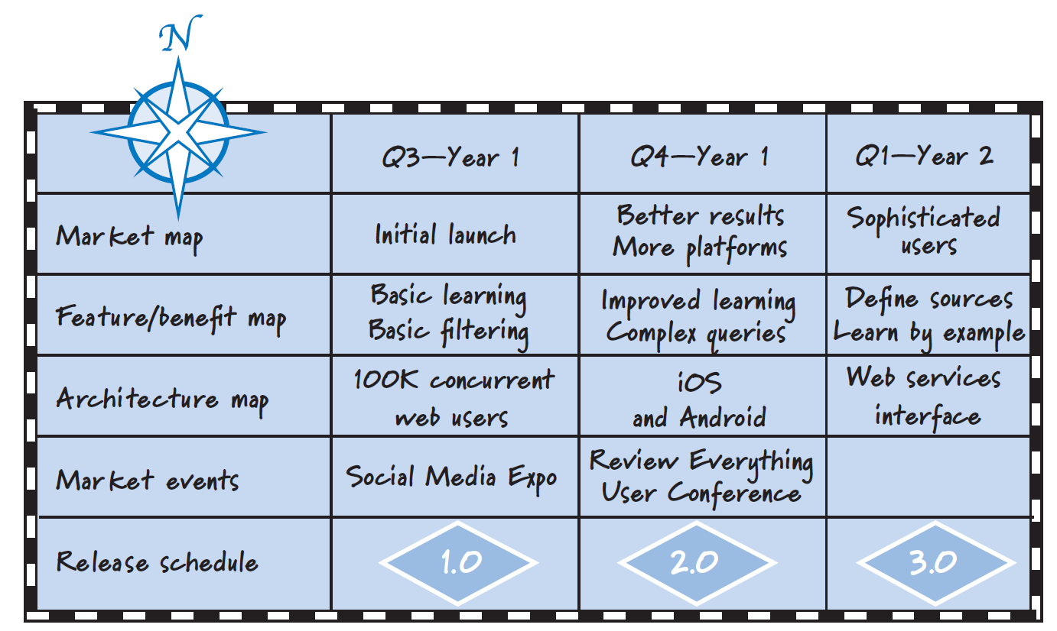
Product Roadmap Duration
When using Scrum, we produce the product roadmap as far into the future as is reasonable and desirable.
How far into the future your roadmap should extend will depend on your particular circumstances.
At a minimum, your roadmap will probably need to cover at least the span of time you are asking people to fund.

Slide 14
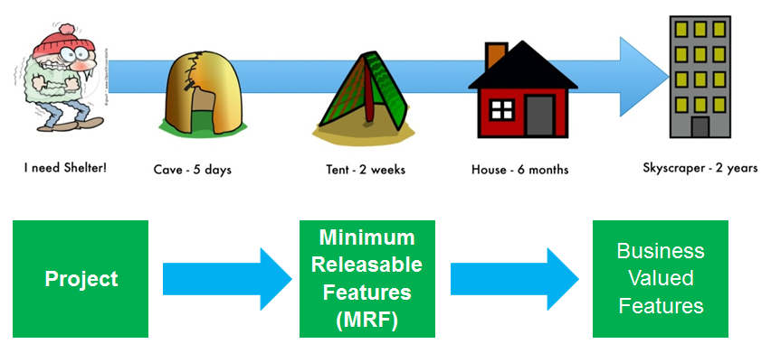

Release Planning [3]
Release planning is longer-term planning that enables us to answer questions like “When will we be done?” or “Which features can I get by the end of the year?” or “How much will this cost?”
Release planning is not a one-time event but rather a frequent, every-sprint activity.
Each release should have a well-defined set of minimum releasable features (MRFs).

Slide 15
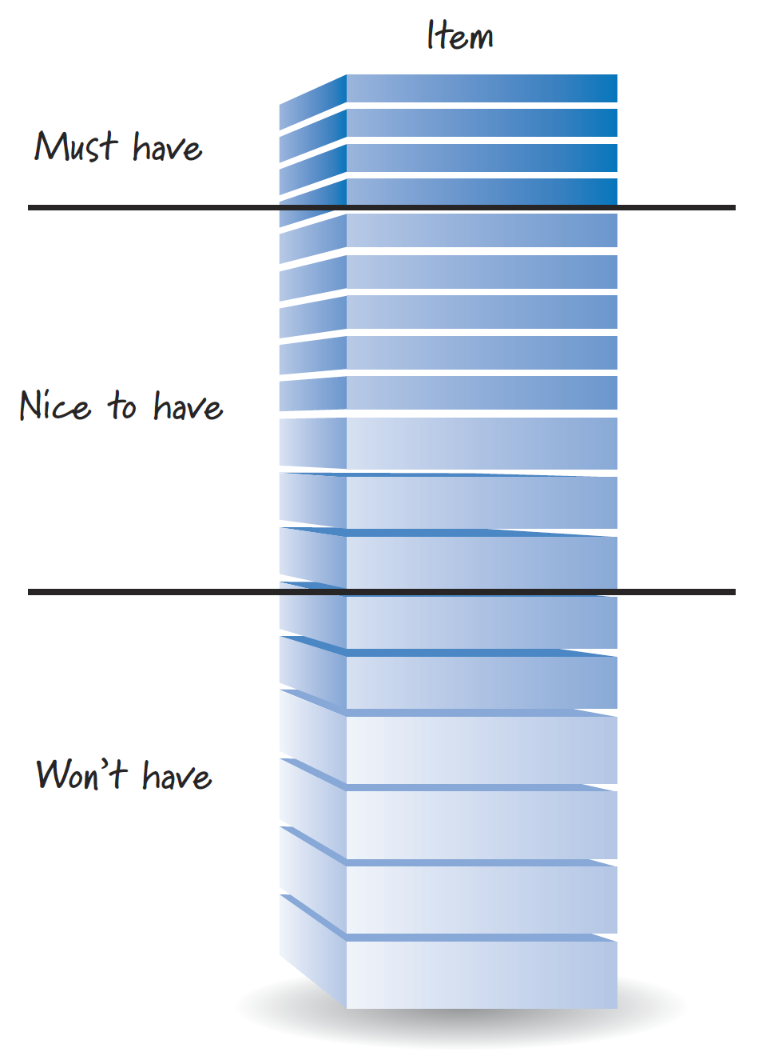
3. Prioritize Backlog Items
Use a story map (business workflows) to determine business value.

Slide 16
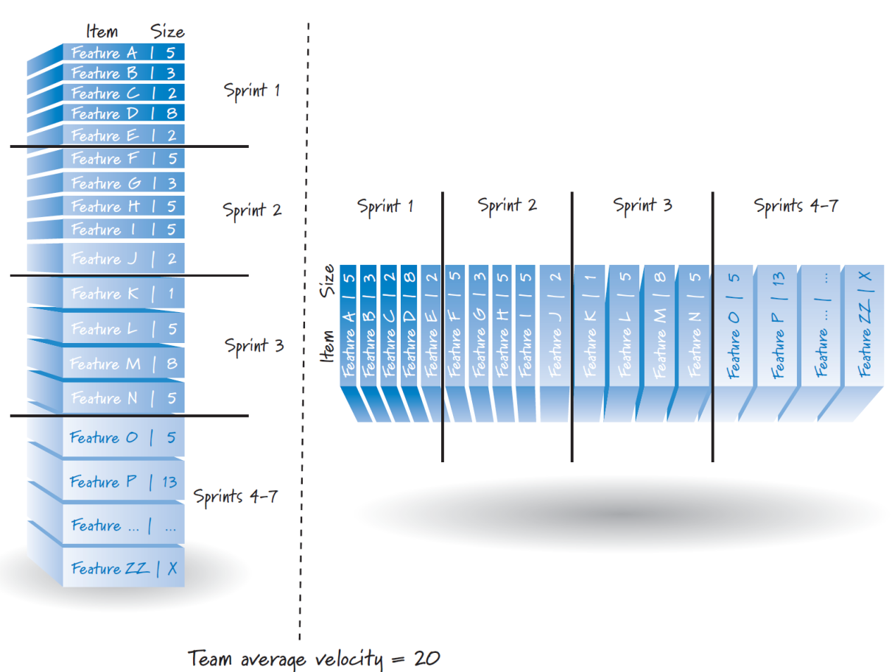
4. Create a Sprint Map
During release planning many organizations also produce a sprint map, indicating in which sprint some or many of the product backlog items might be created.
Using our team's velocity, we can approximate a set of product backlog items for each sprint by grouping together items whose aggregate size roughly equals the team's average velocity.
Sprint Mapping (PBI Slotting)

Slide 17
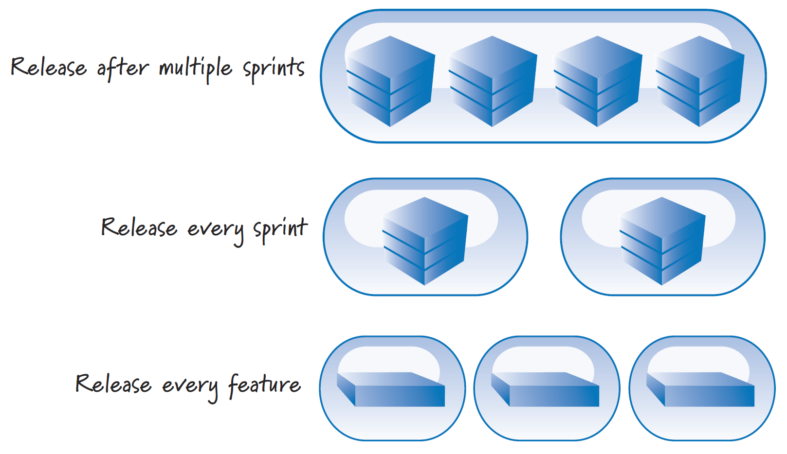
5. Create a Preliminary Release Plan
Before starting a release, many organizations that use Scrum conduct initial release planning to create a preliminary release plan.
Scrum release vs. product release.
Different release cadences

Slide 18
Example Preliminary Release Plan
Product Release 1 (10/04/2021)
F1
Product Release 2 (11/29/2021)
Product Release 3 (12/27/2021)
F2
F3
F6
F7
F10
F11
F12
F4
F5
F8
F9

Slide 20
6. Identify Release Constraints
In Scrum, we don't believe it's possible to get it all right up front; consequently, we also contend that a fixed-everything approach probably won't work.
Fixing scope and date and allowing the budget to be flexible assumes that applying more resources to a problem will increase the amount of work we accomplish and/or reduce the amount of time it takes to perform the work.
Project Type | Scope | Date | Budget
Fixed everything (not recommended) | Fixed | Fixed | Fixed
Fixed scope and date (not recommended) | Fixed | Fixed | Flexible
Fixed scope | Fixed | Flexible | Fixed (not really)
Fixed date | Flexible | Fixed | Fixed

Slide 21

7a. Create a Fixed-Date Release Plan (I)
Determine how many sprints are in this release.
Groom the product backlog to a sufficient depth by creating, estimating the size of, and prioritizing product backlog items.
Measure or estimate the team's velocity as a range (i.e. determine an average faster and an average slower velocity for the team).

Slide 22
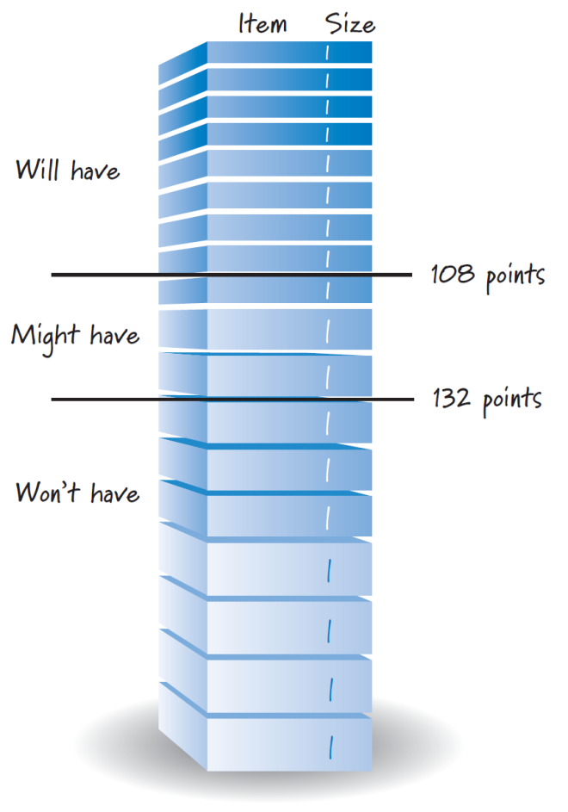
7a. Create a Fixed-Date Release Plan (II)
Multiply the slower velocity by the number of sprints.
Count down that number of points into the product backlog and draw a line. This is the “will-have” line.
Multiply the faster velocity by the number of sprints.
Count down that number of points into the product backlog and draw a second line. This is the “might-have” line.

Slide 23
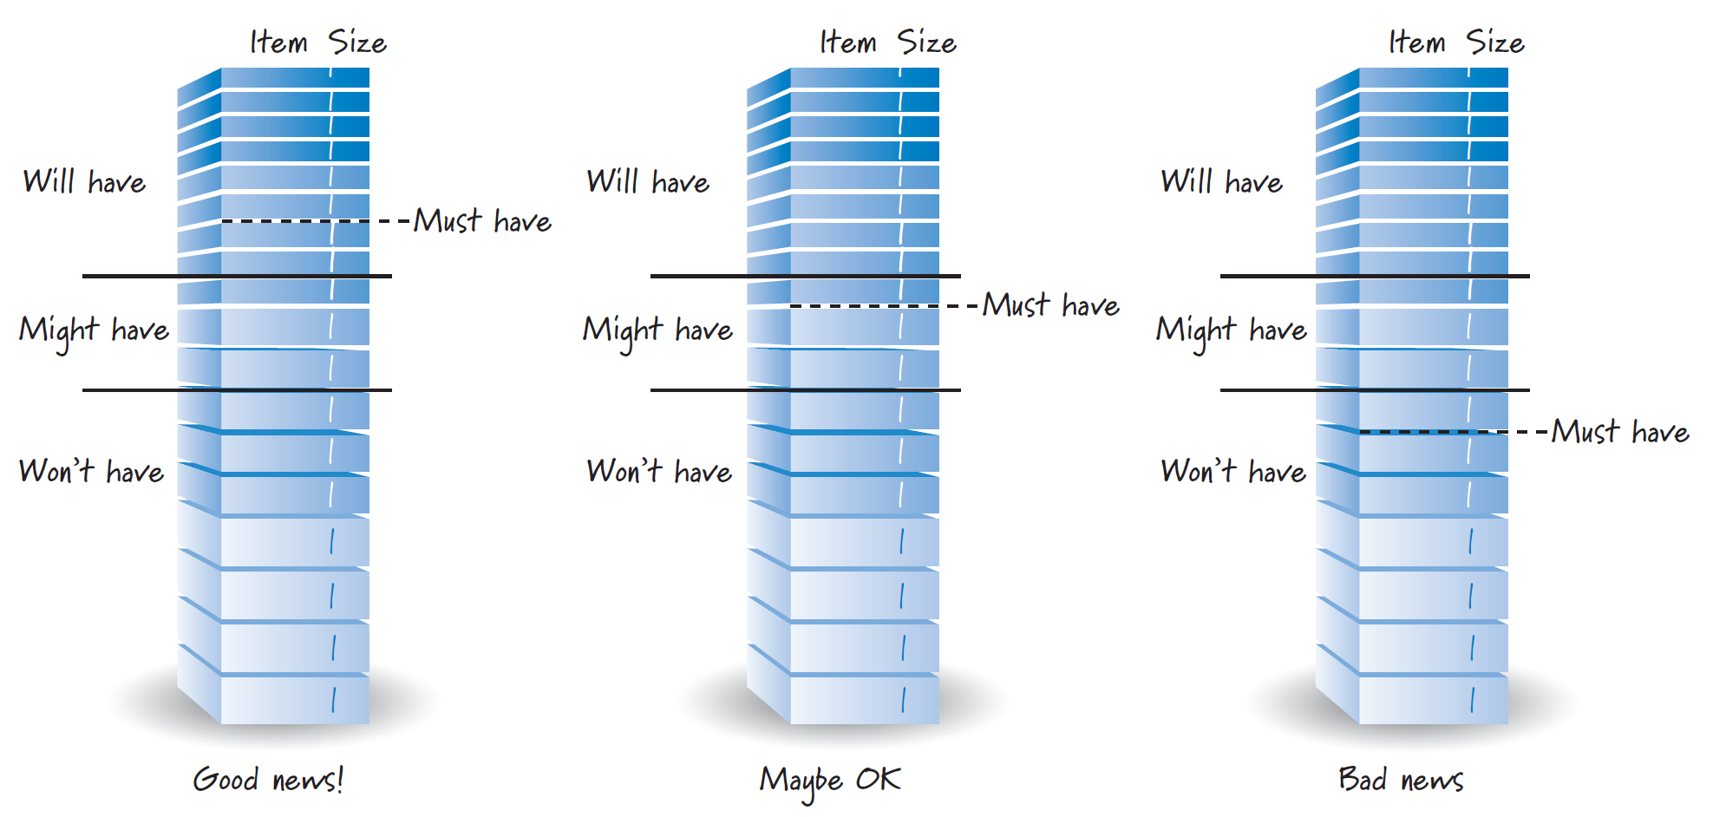
Should We Proceed This Plan?
This approach illustrates how we can give a range answer to the question “What will I get by the release date?”
Location of must-have features relative to the range of deliverable features:

Slide 25
7b. Create a Fixed-Scope Release Plan (I)
Groom the product backlog to include at least the PBIs we would like in this release by creating, estimating the size of, and prioritizing PBIs.
Determine the total size of the PBIs to be delivered in the release.
Measure or estimate the team's velocity as a range. Determine an average faster and an average slower velocity for the team.

Slide 26
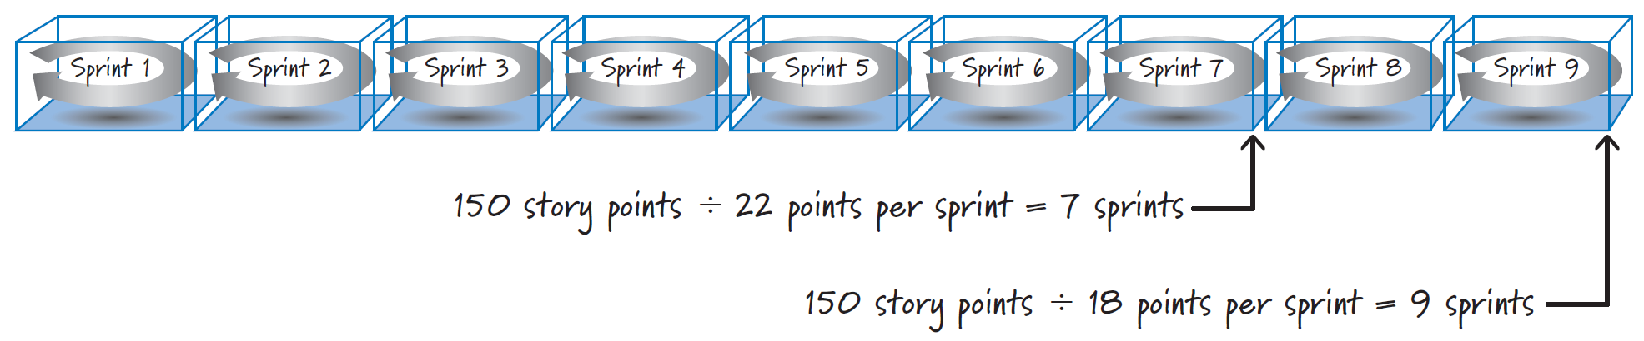
7b. Create a Fixed-Scope Release Plan (II)
Divide the total size of the PBIs by the faster velocity and round up the answer to the next integer. This will tell us the lowest number of sprints required to deliver the features.
Divide the total size of the PBIs by the slower velocity and round up the answer to the next integer. This will tell us the highest number of sprints required to deliver the features.

Slide 28

8. Calculate Release Cost
Determine who is on the team.
Determine the sprint length.
Based on team composition and sprint length, determine the personnel costs of running a sprint.
For a fixed-date release, multiply the number of sprints in the release by the cost per sprint.
For a fixed-scope release, multiply both the high and low number of sprints by the cost per sprint. The results are the range of personnel costs associated with the release.

Slide 29
9. Create Project (Release) Estimate
Project: XYZ.
Start: 09/06/21. Finish: 12/27/21
Size: 720 points. Duration: 80 days. Cost: $61580.
Milestones:
Milestone 1: 09/20/21: Story 1, Story 2, Story 3 (10 days)
Milestone 2: 10/04/21: Story 4, Story 5 (10 days)
Milestone 3: 11/01/21: Story 6, Story 7 (20 days)
Milestone 4: 11/29/21: Story 8 (20 days)
Milestone 5: 12/27/21: Story 9 (20 days)

Slide 31

10. Prepare for Release [2]
Definition of project team(s) for the building of the new release.
Assessment of risk and appropriate risk controls.
Validation or reselection of development tools and infrastructure.
Estimation of release cost, including development, collateral material, marketing, training, and rollout.
Verification of management approval and funding.

Slide 32
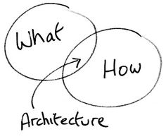
11. Create a System Architecture for Release
Review assigned backlog items.
Identify changes necessary to implement backlog items.
Perform domain analysis to the extent required to build, enhance, or update the domain models to reflect the new system context and requirements.
Refine the system architecture to support the new context and requirements.
Identify any problems or issues in developing or implementing the changes.
Design review meeting, each team presenting approach and changes to implement each backlog item. Reassign changes as required.

Slide 33
How Should Architectural Design Be Done?
Often the architect identifies the major components then defines the interfaces between them (including nonfunctional requirements like security, speed and reliability) and delegates the internal design of the components to individual teams.
An overview consisting of a high level network or component diagram and a page of text. This is for a very wide audience, from upper management down to dev and QA. This rarely uses UML or a defined notation due to the wide audience.
In agile environments, less of the design is done upfront and more of it is delegated to component teams.

Slide 34
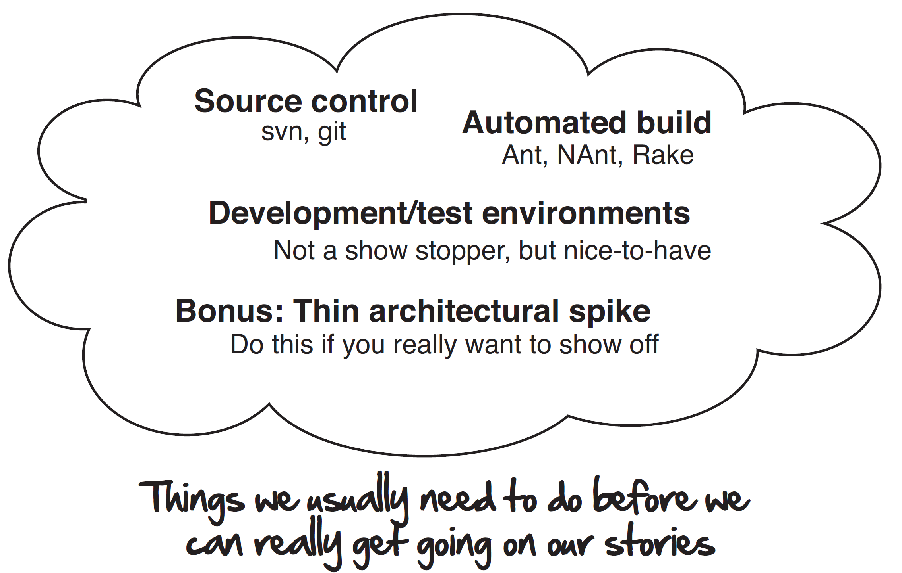
12. Execute the Iteration 0 [4]

Slide 36
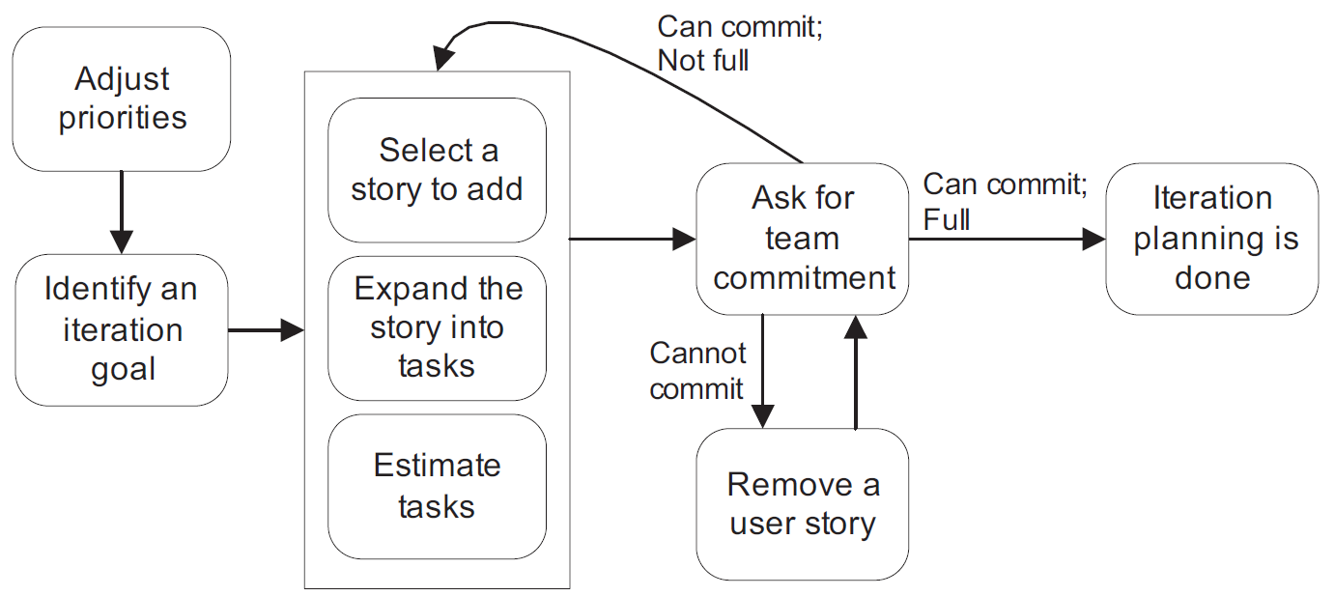
Sprint Planning [1]
Commitment-Driven Iteration Planning

Slide 37
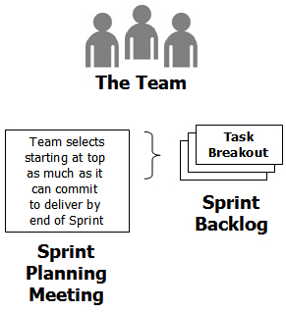
13. Create a Sprint Backlog
The sprint backlog is the list of work the team must address during the next sprint.

Slide 38
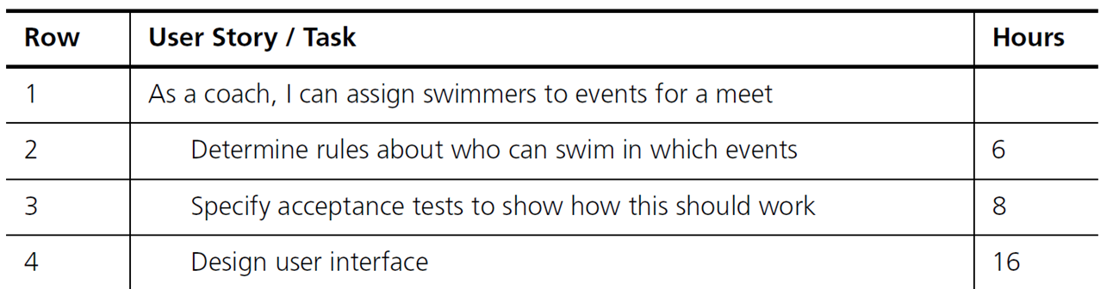
14. Create Sprint Tasks
Features are broken down into tasks, which, as a best practice, should normally be between four and sixteen hours of work.
Individuals do not sign up for tasks until the iteration begins and generally only sign up for one or two related tasks at a time.
New tasks are not begun until previously selected ones are completed.

Slide 39

15. Discuss about the Sprint Plan
Sprint deliverables
How to achieve the sprint deliverables?
Agreement between Product Owner and the Team.
What if the sprint deliverables cannot be achieved?

Slide 40
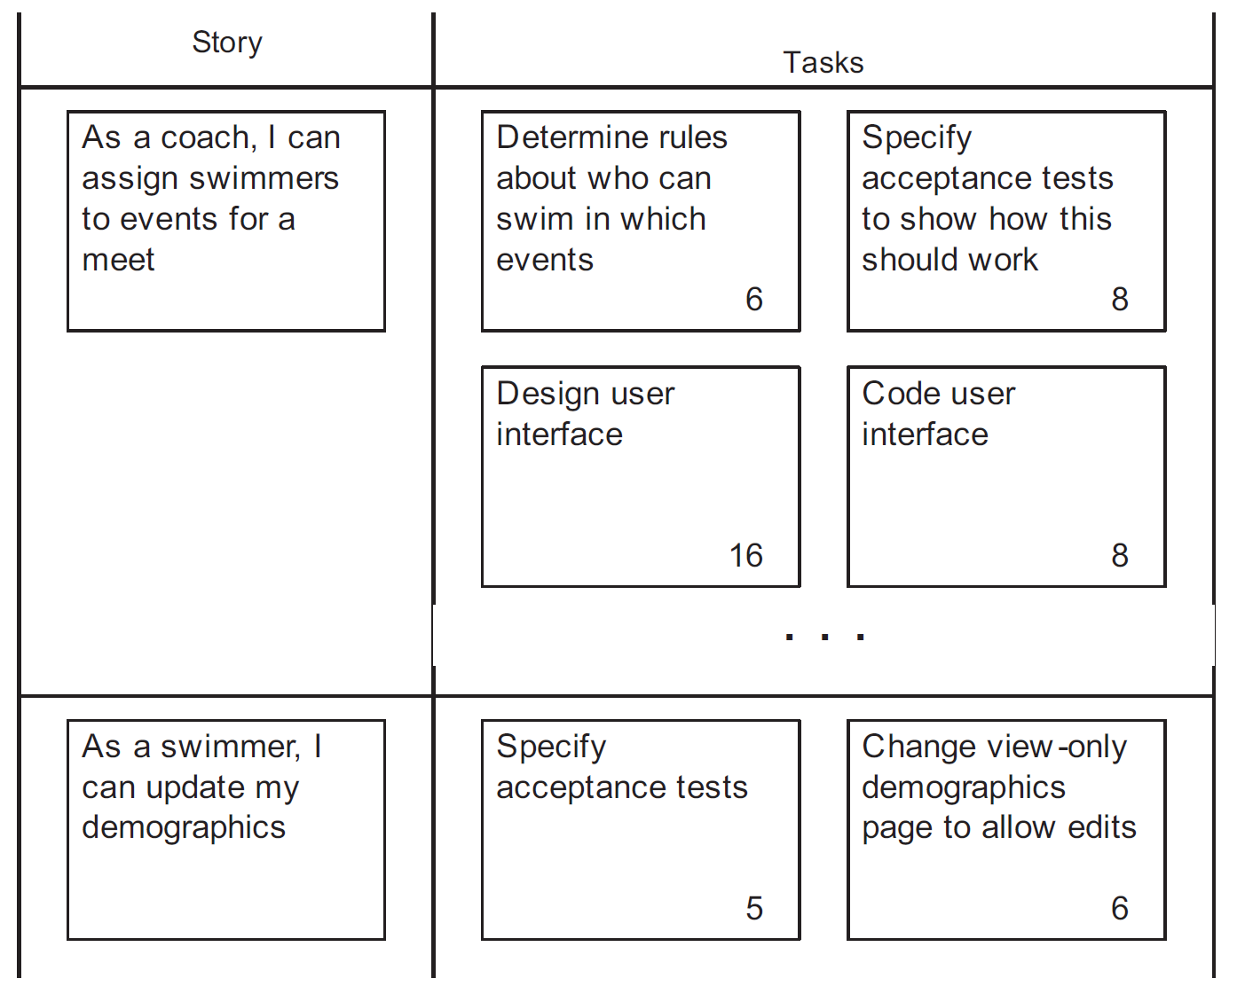
16. Create Cards

Slide 42


Traditional Fixed-Price Contract [5]
This contract is governed on the basis of subject matter (scope) that is complete and specified in complete detail according to compensation and acceptance and delivery dates.
The contract is based on the assumption that customers know, or assumes to know, what he or she wants to have delivered.
A fixed-price project is based mostly on a clearly specified waterfall project cycle (a predictive process).

Slide 43



The Perspective of the Customer
No changes: low risk.
Price is known beforehand.
On time and on budget
Bidding process
Safe feeling of control
based on predictive model
Changes happen: high cost.
Incomplete and unpredictable information
from insignificant descriptions.
Wrong timing of detailed requirements.
Wrong requirements.

Slide 44

The Perspective of the Supplier
No changes: low risk.
Good project manager and the appropriate expertise in place.
The supplier must ultimately deliver what is specified in the contract requirements. If parts are missing, there is a change request, which, since the project has already been awarded to the supplier, can be priced without pressure from the competition.
Normally, the expertise on a project is higher on the supplier side than on the customer side. The fixed-price contract usually contains a comprehensive catalog of assumptions added by the supplier.
High risk: no expertise in place.
Changes happen: additional revenue.

Slide 45

The Perspective of the Consultant
For contracts that are not supported by cooperative spirit and mutual trust, customers like to use external expertise and experience to increase the probability of a successful project.
Success is never guaranteed, however, and this is a risk for a consultant who is not content with being associated with failing projects.

Slide 46

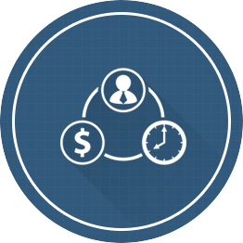
Time and Materials Contract
This contract is usually governed on the basis of experience levels (e.g., junior, senior) and roles (e.g., analysis, testers, developers, project managers, or even an entire Scrum team) and the subsequent cost for one day (or hour) of delivery within the framework of an IT project (design, management, testing, etc.).
Many IT projects cannot be described fully and clearly in advance.
You often cannot guess what could still change during the project.
The customer buys the resources with appropriate knowledge and experience and uses it to achieve the project goals.

Slide 47

The Perspective of the Customer
Micromanagement and constant supervision are necessary to get the maximum value out of the resources available to a project.
The entire responsibility for what and how something is done is up to the project manager and thus the customer.
The customer is required to work with transparency and constantly monitor the level of documentation delivery performance.
This produces questionable efficiency and means paying at the end for time rather than for performance.

Slide 48

The Perspective of the Supplier
In the sales process, the supplier always places the best horses in the race. They work under the premise that the maximum performance, transparency and documentation must be delivered to the customer.
However, the staff of the provider often performs inadequate documentation, thus promoting client dependency.
The supplier's management wants to maximize profits and will try, within a framework of acceptable quality, to replace the expensive resources and skills with cheaper ones.
There are no consequences for the supplier if the project should get out of control financially.

Slide 49

The Perspective of the Consultant
The consultant is also usually a supplier on the basis of time and materials.
He or she can judge whether the service provided was of adequate quality and whether it has been documented sufficiently.
What is lacking in this type of contract is the clear position to pay, not for time, but for performance (value or business value) which is necessary to achieve the common project goals.

Slide 50
Agile Fixed-Price Contract
Project vision
Indicative fixed-price (a maximum price)
Checkpoint phase
A period of x sprints or a performance scope of y story points is agreed upon as the test phase of cooperation.
Risk share
If exceeding the maximum price cannot be avoided even through the actions agreed to by the project's governance, the additional supplier costs are charged at only x% of the agreed-upon team costs. The value x should lie between 30 and 70% and is one of the parameters that must be fixed during negotiation.
Exit points
Scope governance process, scope escalation process

Slide 51
Agile Fixed-Price Contract Review
An agile fixed price contract is similar to a time and material contract, in which, a client is charged by time and materials and any party can leave the contract with a reasonable lead time.
The 4 key differences are that:
A rough estimate (which is a “fixed” price) is made based on a rough initial product backlog.
If the actual cost exceeds the rough estimate then both client and supplier share the cost (the time and materials cost then is only 30% or 40% of the original charge. This value is negotiated.)
Requirements can be changed and will be evaluated against the “fixed” price by a board and negotiated within the “fixed” price. Usually, this will replace an old backlog item with a new one (for supplier's safety).
Quality working software with adequate documentation is delivered every 2-3 weeks to client (for client's safety).
IMO, I think the weakest point is that a supplier can leave the contract as soon as all the budget (“fixed” price) is spent despite getting a bad reputation.

Slide 52

Thank You & See You Again

